Slide 1
Introduction to Machine Learning
Iftekhar Mahmud Towhid

Slide 2
What is learning?
“Learning is any process by which a system improves performance from experience.”

Slide 3
Machine learning
Machine learning (ML) is a branch of artificial intelligence (AI) that focuses on developing algorithms that can learn from and make predictions or decisions based on data. Instead of being explicitly programmed to perform a task, these algorithms improve their performance as they are exposed to more data over time.
  A branch of AI
  Not explicitly programmed (Unlike traditional algorithms)
  Used to make predictions or decisions based on provided data
  Improves performance over time if exposed to more data

Slide 4
Comparison with traditional programming
Traditional programming
Machine learning
Data
Computer
Output
Program
Data
Computer
Program
Output

Slide 5
Comparison with traditional programming
Given a problem, and some data (input and output) regarding the problem, using machine learning we try to develop a model that behaves like a program that provides solution to that problem.
Thus:
  Not explicitly programmed
  We used real data to train (learn patterns in the data) the model
  The output of the training is a learned model. There a many types of models that we can use. For example, Neural Networks, Support Vector Machines etc.

Slide 6
When do we use Machine Learning?
ML is used when:
  Human expertise does not exist (navigating on Mars)
  Humans can't explain their expertise (speech recognition)
  Models must be customized (personalized medicine)
  Models are based on huge amounts of data (genomics)
Learning isn't always useful:
  There is no need to "learn" to calculate payroll

Slide 7
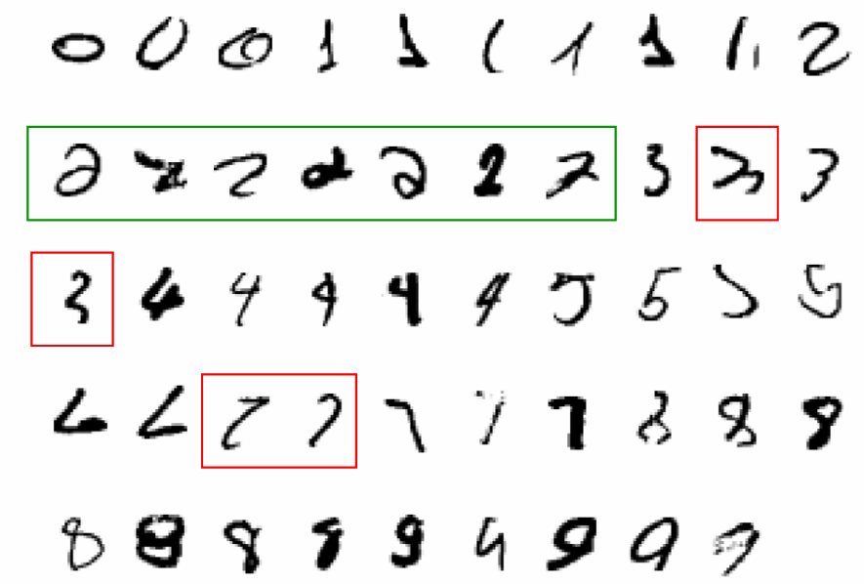
Example
A classic example of a task that requires machine learning:
  It is very hard to say what makes a 2

Slide 8
Examples
Some more examples of tasks that are best solved by using a learning algorithm
  Recognizing patterns:
    Facial identities or facial expressions
    Handwritten or spoken words
    Medical images
  Generating patterns:
    Generating images or motion sequences
  Recognizing anomalies:
    Unusual credit card transactions
    Unusual patterns of sensor readings in a nuclear power plant
  Prediction:
    Future stock prices or currency exchange rates

Slide 9
Machine learning vs AI vs deep learning
Machine learning is often confused with artificial intelligence or deep learning. Let's take a look at how these terms differ from one another.
  AI refers to the development of programs that behave intelligently and mimic human intelligence through a set of algorithms.
  Machine learning is a subset of AI, which uses algorithms that learn from data to make predictions. These predictions can be generated through supervised learning, where algorithms learn patterns from existing data, or unsupervised learning, where they discover general patterns in data.
  Deep learning, on the other hand, is a subfield of machine learning dealing with algorithms based essentially on multi-layered artificial neural networks (ANN) that are inspired by the structure of the human brain.Unlike conventional machine learning algorithms, deep learning algorithms are less linear, more complex, and hierarchical, capable of learning from enormous amounts of data, and able to produce highly accurate results.

Slide 10
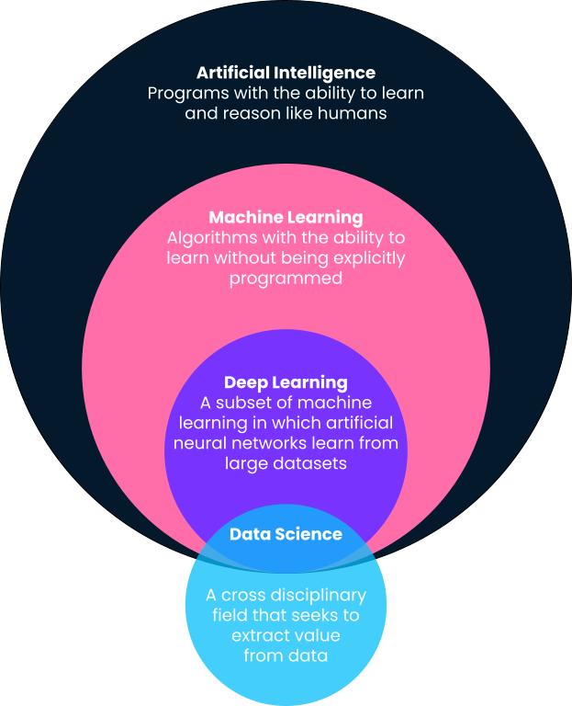

Slide 11
How Does Machine Learning Work?
Project setup
Data Preparation
Modeling
Deployment
Understanding how machine learning works involves delving into a step-by-step process that transforms raw data into valuable insights. Let's break down this process:

Slide 12
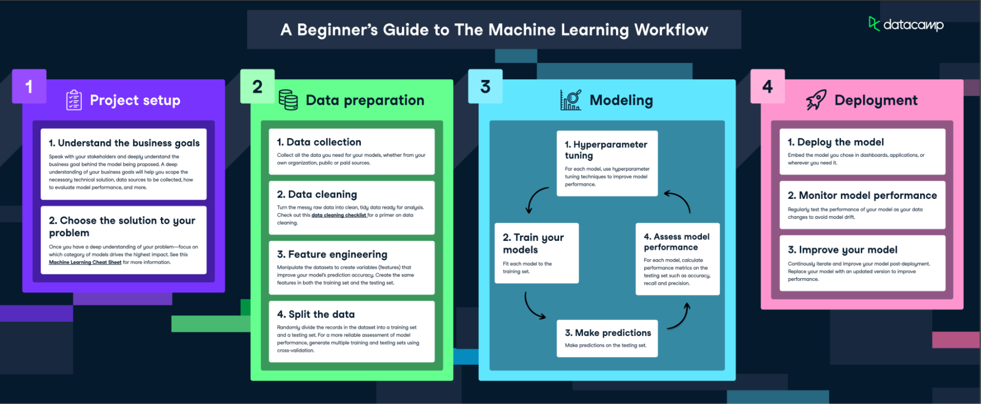

Slide 13
Step 1: Project Setup
Understand business goals
  Speak with your stakeholders and deeply understand the business goal behind the model being proposed. A deep understanding of your business goals will help you scope the necessary technical solution, data sources to be collected, how to evaluate model performance, and more.
Choose the solution to your problem
  Once you have a deep understanding of your problem—focus on which category of models drives the highest impact. See this Machine Learning Cheat Sheet for more information.

Slide 14
Step 2: Data preparation
Data collection
  Data is the lifeblood of machine learning - the quality and quantity of your data can directly impact your model's performance. Data can be collected from various sources such as databases, text files, images, audio files, or even scraped from the web.
  Collect all the data you need for your models, whether from your own organization, public or paid sources.
Data preprocessing
  Data preprocessing is a crucial step in the machine learning process. It involves cleaning the data (removing duplicates, correcting errors), handling missing data (either by removing it or filling it in), and normalizing the data (scaling the data to a standard format).
  Preprocessing improves the quality of your data and ensures that your machine learning model can interpret it correctly. This step can significantly improve the accuracy of your model.
  Check out this data cleaning checklist for a primer on data cleaning.

Slide 15
Step 2: Data preparation (cont.)
Feature engineering
  Manipulate the datasets to create variables (features) that improve your model’s prediction accuracy. Create the same features in both the training set and the testing set.
Split the data
  Randomly divide the records in the dataset into a training set and a testing set. For a more reliable assessment of model performance, generate multiple training and testing sets using cross validation

Slide 16
Step 3: Modeling
Choosing the right model
  Once the data is prepared, the next step is to choose a machine learning model. There are many types of models to choose from, including linear regression, decision trees, and neural networks. The choice of model depends on the nature of your data and the problem you're trying to solve.
  Factors to consider when choosing a model include the size and type of your data, the complexity of the problem, and the computational resources available.

Slide 17
Step 3: Modeling (cont.)
Train your models
  After choosing a model, the next step is to train it using the prepared data. Training involves feeding the data into the model and allowing it to adjust its internal parameters to better predict the output.
  During training, it's important to avoid overfitting (where the model performs well on the training data but poorly on new data) and underfitting (where the model performs poorly on both the training data and new data).
Evaluating the model
  Once the model is trained, it's important to evaluate its performance before deploying it. This involves testing the model on new data it hasn't seen during training.
  Common metrics for evaluating a model's performance include accuracy (for classification problems), precision and recall (for binary classification problems), and mean squared error (for regression problems). [For a review on these metrics, revisit this document]

Slide 18
Step 3: Modeling (cont.)
Hyperparameter tuning and optimization
  After evaluating the model, you may need to adjust its hyperparameters to improve its performance. This process is known as parameter tuning or hyperparameter optimization.
  Techniques for hyperparameter tuning include grid search (where you try out different combinations of parameters) and cross validation (where you divide your data into subsets and train your model on each subset to ensure it performs well on different data).
Make predictions
  Once the model is trained and optimized, it's ready to make predictions on new data. This process involves feeding new data into the model and using the model's output for decision-making or further analysis.

Slide 19
Step 4: Deployment
Deploy the model
  Deploying the model involves integrating it into a production environment where it can process real-world data and provide real-time insights. This process is often known as MLOps.
  Embed the model you chose in dashboards, applications, or wherever you need it.
Monitor model performance
  Regularly test the performance of your model as your data changes to avoid model drift
Improve your model
  Continuously iterate and improve your model post deployment. Replace your model with an updated version to improve performance.

Slide 20
Types of Machine Learning
Machine learning can be broadly classified into three types based on the nature of the learning system and the data available:
  supervised learning,
  unsupervised learning, and
  reinforcement learning.

Slide 21
Supervised learning
Supervised learning is the most common type of machine learning. In this approach, the model is trained on a labeled dataset. In other words, the data is accompanied by a label that the model is trying to predict. This could be anything from a category label to a real-valued number.
The model learns a mapping between the input (features) and the output (label) during the training process. Once trained, the model can predict the output for new, unseen data.
Common examples of supervised learning algorithms include linear regression for regression problems and logistic regression, decision trees, and support vector machines for classification problems. In practical terms, this could look like an image recognition process, wherein a dataset of images where each picture is labeled as "cat," "dog," etc., a supervised model can recognize and categorize new images accurately.

Slide 22
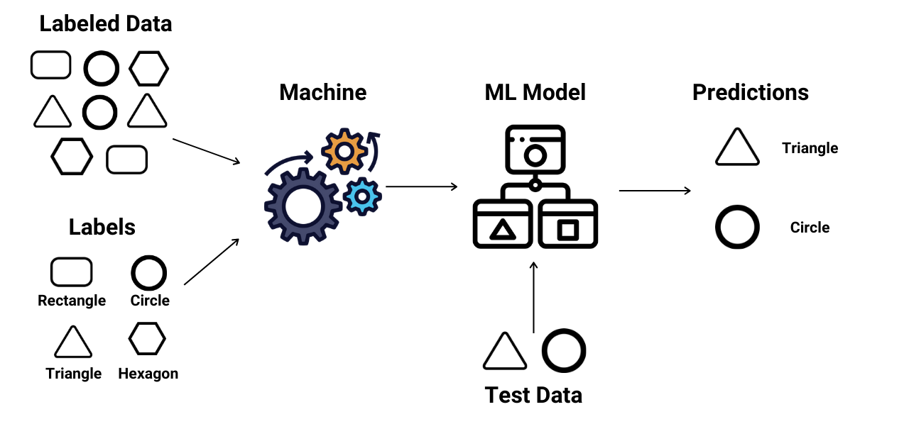
Supervised learning

Slide 23
Regression vs. Classification
There are two main types of supervised learning algorithms:
  Regression: Regression is a type of supervised learning where the algorithm learns to predict continuous values based on input features. The output labels in regression are continuous values, such as stock prices, and housing prices. The different regression algorithms in machine learning are: Linear Regression, Polynomial Regression, Ridge Regression, Decision Tree Regression, Random Forest Regression, Support Vector Regression, etc.
  Classification: Classification is a type of supervised learning where the algorithm learns to assign input data to a specific category or class based on input features. The output labels in classification are discrete values. Classification algorithms can be binary, where the output is one of two possible classes, or multiclass, where the output can be one of several classes. The different Classification algorithms in machine learning are: Logistic Regression, Naive Bayes, Decision Tree, Support Vector Machine (SVM), K-Nearest Neighbors (KNN), etc.

Slide 24
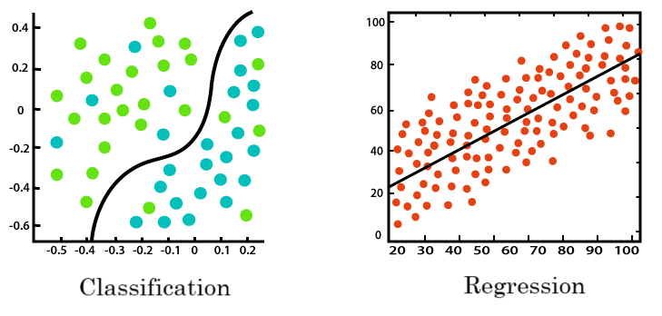
Regression vs. Classification

Slide 25
Unsupervised learning
Unsupervised learning, on the other hand, involves training the model on an unlabeled dataset. The model is left to find patterns and relationships in the data on its own.
This type of learning is often used for clustering and dimensionality reduction. Clustering involves grouping similar data points together, while dimensionality reduction involves reducing the number of random variables under consideration by obtaining a set of principal variables.
Common examples of unsupervised learning algorithms include k-means for clustering problems and Principal Component Analysis (PCA) for dimensionality reduction problems. Again, in practical terms, in the field of marketing, unsupervised learning is often used to segment a company's customer base. By examining purchasing patterns, demographic data, and other information, the algorithm can group customers into segments that exhibit similar behaviors without any pre-existing labels.

Slide 26
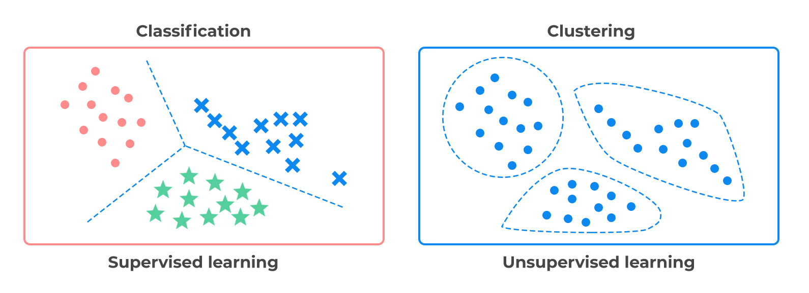
Supervised vs Unsupervised Learning

Slide 27
Reinforcement learning
Reinforcement learning is a type of machine learning where an agent learns to make decisions by interacting with its environment. The agent is rewarded or penalized (with points) for the actions it takes, and its goal is to maximize the total reward.
Unlike supervised and unsupervised learning, reinforcement learning is particularly suited to problems where the data is sequential, and the decision made at each step can affect future outcomes.
Common examples of reinforcement learning include game playing, robotics, resource management, and many more.

Slide 28
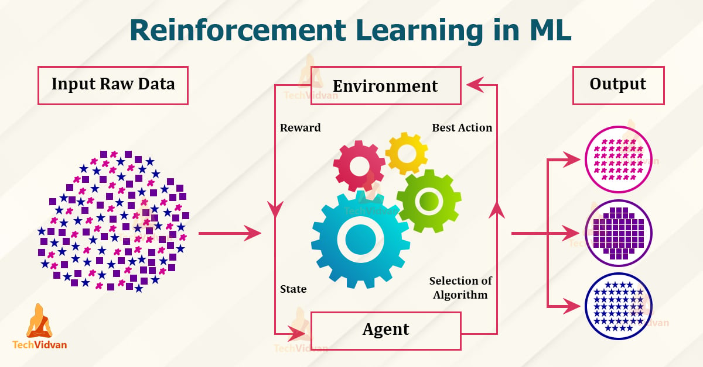
Reinforcement learning

Slide 29
Machine Learning Tools
In the world of machine learning, having the right tools is just as important as understanding the concepts. These tools, which include programming languages and libraries, provide the building blocks to implement and deploy machine learning algorithms. Let's explore some of the most popular tools in machine learning:

Slide 30
Machine Learning Tools
Python for machine learning
  Python is a popular language for machine learning due to its simplicity and readability, making it a great choice for beginners. It also has a strong ecosystem of libraries that are tailored for machine learning.
  Libraries such as NumPy and Pandas are used for data manipulation and analysis, while Matplotlib is used for data visualization. Scikit-learn provides a wide range of machine learning algorithms, and TensorFlow and PyTorch are used for building and training neural networks.

Slide 31
Machine Learning Tools
TensorFlow
  TensorFlow is a powerful open-source library for numerical computation, particularly well-suited for large-scale machine learning. It was developed by the Google Brain team and supports both CPUs and GPUs.
  TensorFlow allows you to build and train complex neural networks, making it a popular choice for deep learning applications.

Slide 32
Machine Learning Tools
PyTorch
  PyTorch is an open-source machine learning library based on the Torch library. It's known for its flexibility and efficiency, making it popular among researchers.
  PyTorch supports a wide range of applications, from computer vision to natural language processing. One of its key features is the dynamic computational graph, which allows for flexible and optimized computation.

Slide 33
Machine Learning Tools
Scikit-learn
  Scikit-learn is a Python library that provides a wide range of machine learning algorithms for both supervised and unsupervised learning. It's known for its clear API and detailed documentation.
  Scikit-learn is often used for data mining and data analysis, and it integrates well with other Python libraries like NumPy and Pandas.

Slide 34
Machine Learning Tools
Keras
  Keras is a high-level neural networks API, written in Python and capable of running on top of TensorFlow, CNTK, or Theano. It was developed with a focus on enabling fast experimentation.
  Keras provides a user-friendly interface for building and training neural networks, making it a great choice for beginners in deep learning.

Slide 35
Kaggle
Kaggle is a data science competition platform and online community for data scientists and machine learning practitioners under Google LLC. Kaggle enables users to find and publish datasets, explore and build models in a web-based data science environment, work with other data scientists and machine learning engineers, and enter competitions to solve data science challenges.

Slide 36
Thanks

